Slide 1
BUSINESS DATA management capstone project
Enhancing Profitability and Sales Growth: Data-driven Analysis and Strategies for Louis Phillipe Store
Submitted by
Kunal Gupta- 21f3001818

Slide 2
OUTLINE-
About the business
Problem Statement
Data and Approach
Result and Key Findings
Recommendations

Slide 3
About the business
Business Overview: The project centres around Louis Phillipe, situated in Faridabad, Haryana. This B2C establishment is a Louis Phillipe franchise, specializing in a comprehensive range of high-quality Clothing and general accessories products.
Challenges: Facing sales decline during recession and struggling with effective inventory management and marketing.
Solution Focus: Utilizing data analysis and strategies to address challenges and improve performance.

Slide 4
Problem Statement
Sales Decline: The business experiencing declining sales amid the ongoing recession.
Inventory Management: Struggling with effective inventory management, leading to overstocking or stockouts or deadstock.
Limited Marketing: Lack of knowledge in low-cost and effective marketing strategies to attract customers.

Slide 5
Data and Approach
Data Source: Utilized sales and inventory data from Louis Phillipe for the fiscal year 2022(April- October).
Analytical Approach: Employed a combination of descriptive and predictive analytics techniques.
Tools Used: Utilized Excel for comprehensive sales and inventory analysis and dynamic visualizations, graphs.

Slide 6
Result and Key Findings
Total Sales and Profit: The fiscal year 2022 recorded total sales of 23,51,785 Rs with approx. 35% margin on each item sold.
Average Profit Margin: With an average profit margin of 35% on each good with average profit margin of approx. 20-25%.
Top Sub Categories by Sales: “Shirts, Trousers" and “Blazers, Suits" emerged as significant contributors to sales, indicating strong customer demand, strong written data was not available but soft analysis concluded this.

Slide 7
Transaction via Cash, Card and Other Modes: A pie chart analysis of sales from April to November revealed that credit card transactions were highest in April, May, and July, while cash sales peaked in April and July. Other modes like Paytm UPI declined steadily, suggesting the need for promotion and convenience enhancements.
Total Item sold vs Return: Fluctuations in both items sold and items returned over the past six months, indicating a need for increased customer traffic and potential quality control concerns due to rising returns. Investigating the reasons behind frequent returns and implementing corrective measures is essential to enhance overall retail performance.
Total Bills Month: Over the past seven months, the outlet's monthly bill counts fluctuated. April marked a significant spike with 107 bills, while October saw a drastic decline at only 39 bills, indicating the need for strategic measures to address the decrease in sales.

Slide 8
 | O | OPPORTUNITY
 | 1) | Local Brand Loyalty
 | 2) | Online Presence
 | 3) | Multi-Brand Approach
 | 4) | Tailoring and Alterations
 | 5) | Local Events and Partnerships
 | 6) | Customer Loyalty Programs
 | 7) | Exclusive Collections
 | W | WEAKNESS
 | 1) | Inventory Management
 | 2) | Stock Management
 | 3) | Un-organised Footfall
 | 4) | High Prices
 | 5) | Limited Target Audience
 | 6) | Limited Geographic Presence
 | 7) | Competition
 | T | THREATS
 | 1) | Other brands competition
 | 2) | Economic Downturn
 | 3) | Changing Fashion Trends
 | 4) | Competitive Market
 | 5) | Counterfeiting
 | 6) | Supply Chain Disruptions
 | S | STRENGTH
 | 1) | Strong Brand Reputation
 | 2) | Quality Products
 | 3) | Variety of Products
 | 4) | Effective Marketing
Total Unit Brought vs Total Unit Sold: The consistent surplus of units bought versus units sold throughout the year suggests potential challenges in selling the products, possibly stemming from increased competition, economic conditions, product quality, or marketing effectiveness.
Swot Analysis: The SWOT analysis delves into Louis Phillipe's internal strengths and weaknesses, drawing from customer feedback and industry trends, while also identifying external opportunities and threats from the competitive landscape. This comprehensive assessment guides strategic decision-making to leverage strengths, address weaknesses, capitalize on opportunities, and mitigate potential threats in the market.

Slide 9
Recommendation
Recommendation 1: Optimize high-demand items by keeping prices competitive and ensuring consistent availability to boost revenue and profit. Efficient inventory management based on customer demand is crucial for profitability.
Recommendation 2: During peak months like April and May, hire additional staff to handle the increased customer influx, extend shop hours, and open seven days a week to maximize revenue and customer satisfaction.
Recommendation 3: Stock up on gift items during festive seasons like October and November, and cater to increased demand for formal wear in March and April due to weddings and new academic sessions.
Recommendation 4: Invest in marketing and advertising expertise to promote underperforming items, potentially increasing sales of high-margin items and addressing supply issues caused by funding constraints.
Recommendation 5: Hire a dedicated person to manage supply-related challenges and reduce the need for shop closures, while also exploring alternative suppliers to address external supply-demand mismatches for sustained profitability.

Slide 10
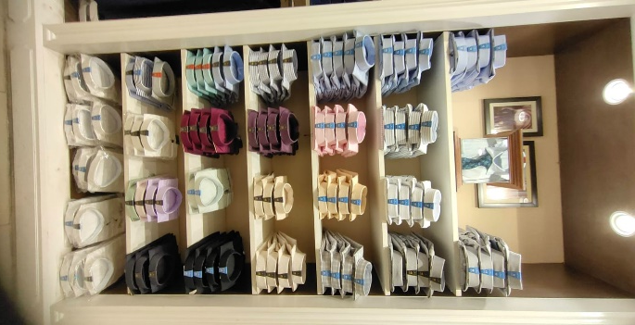
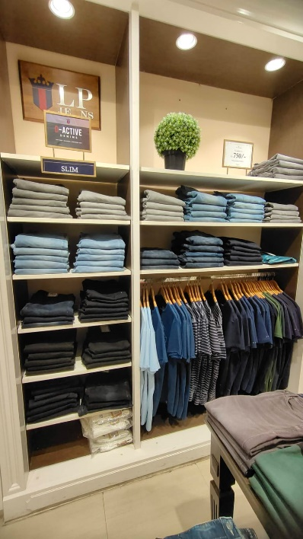
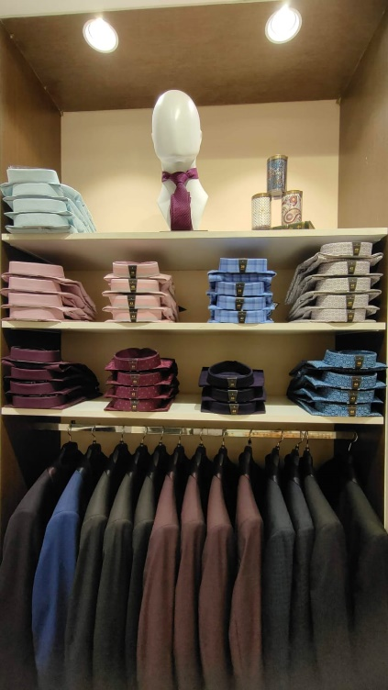
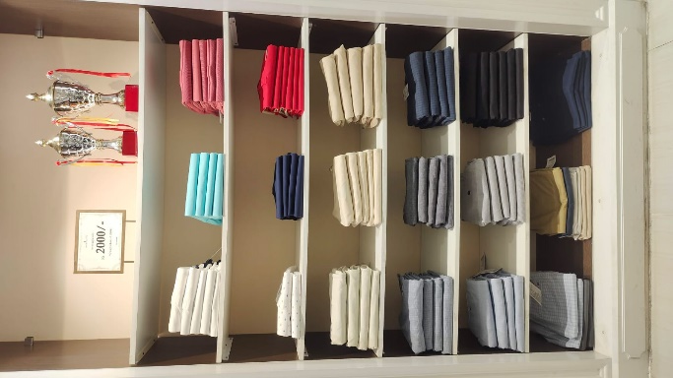
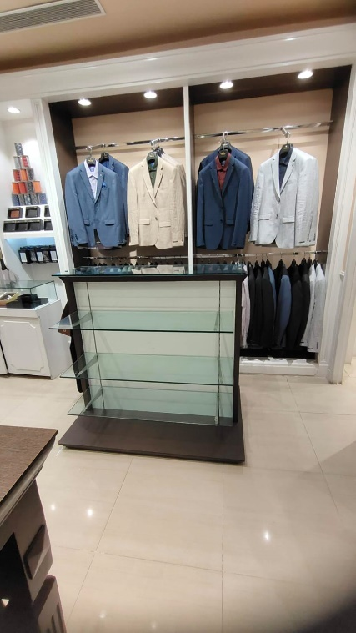
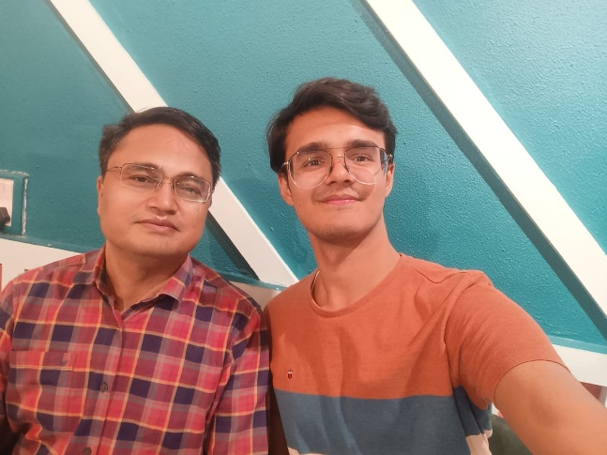
THANK YOU

